Slide 1

VisCommerce Biz Plan Sep 2024
Ramakrishna J Tumuluri
Founder, CEO
rk@viscommerce.com

Slide 2
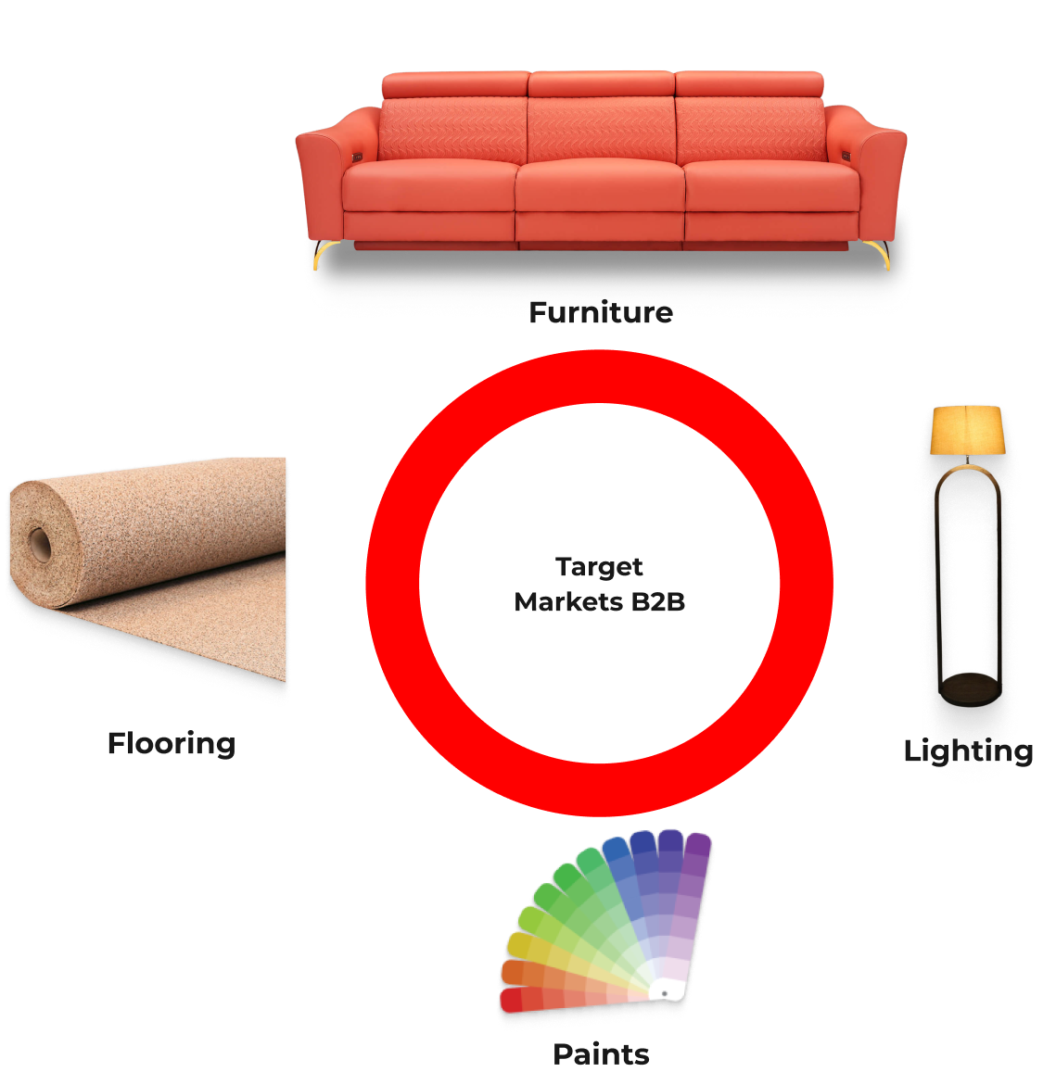
What we do …
Enrich biz with 3DCommerce innovations (B2B)

Slide 3
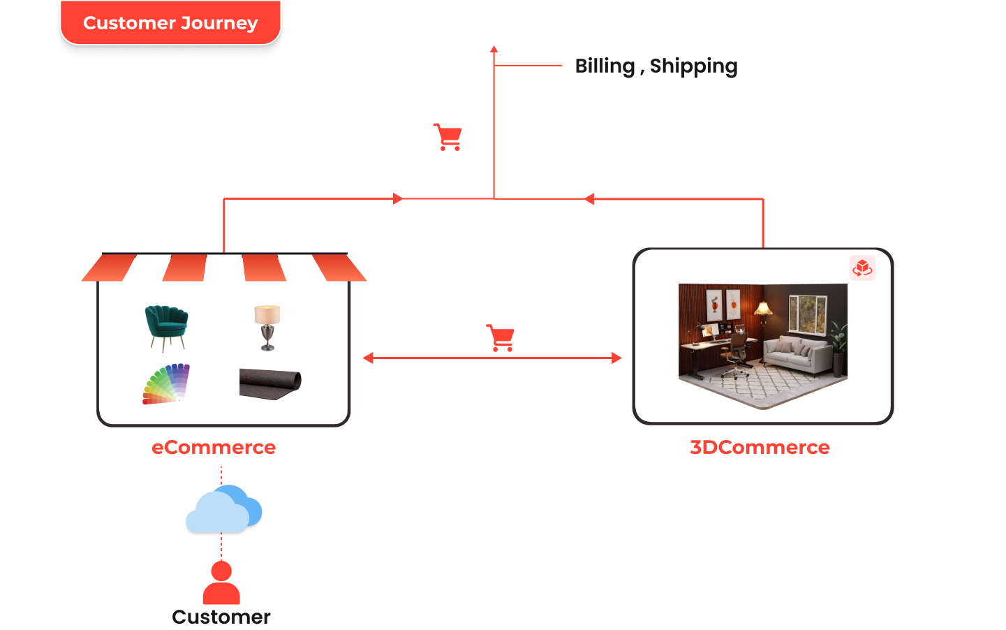
How ?

Slide 4
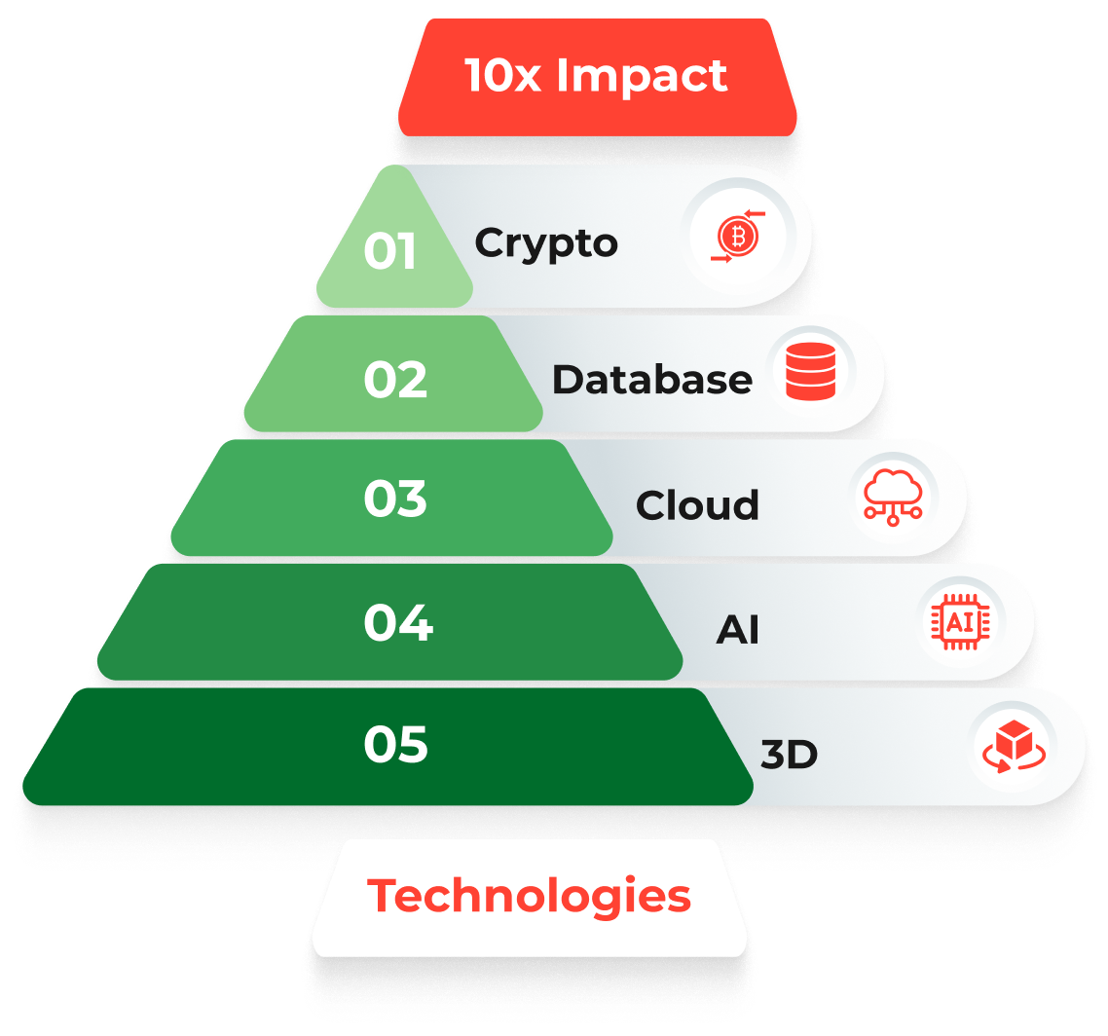
Vision & Mission
Vision
Empower home & office décor with 3DCommerce innovations.
Mission
To innovate, develop and offer 10x impact solutions (B2B)

Slide 5

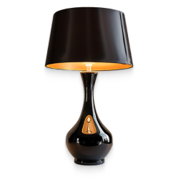
Market & Industry environment
Furniture
$700 bn world-wide
US market approx. $200 bn
Ergonomic furniture market seeing fastest adoption.
Herman-miller, Steelcase etc.
Ikea world #1 furniture vendor
Deployed 3DCommerce solution in-store & online
Lighting
$120 bn world-wide
Interior & exterior
Chandeliers, wall lamps, floor lamps, desk lamps
Waterproof lights, path lights etc.
Unorganized local electricians

Slide 6


Market & Industry environment (cont’d)
Paints
$170 bn world-wide
Interior, exterior
Colors, textures, stencils
Specialized paints depending on surface
Concrete, wood, metal etc.
Unorganized local painters
Flooring
$400 bn world-wide
Interior & exterior
US market
Carpet, wood, vinyl tiles
Indian market
Granite, marble, vitrified tiles
Unorganized local tile-masons

Slide 7
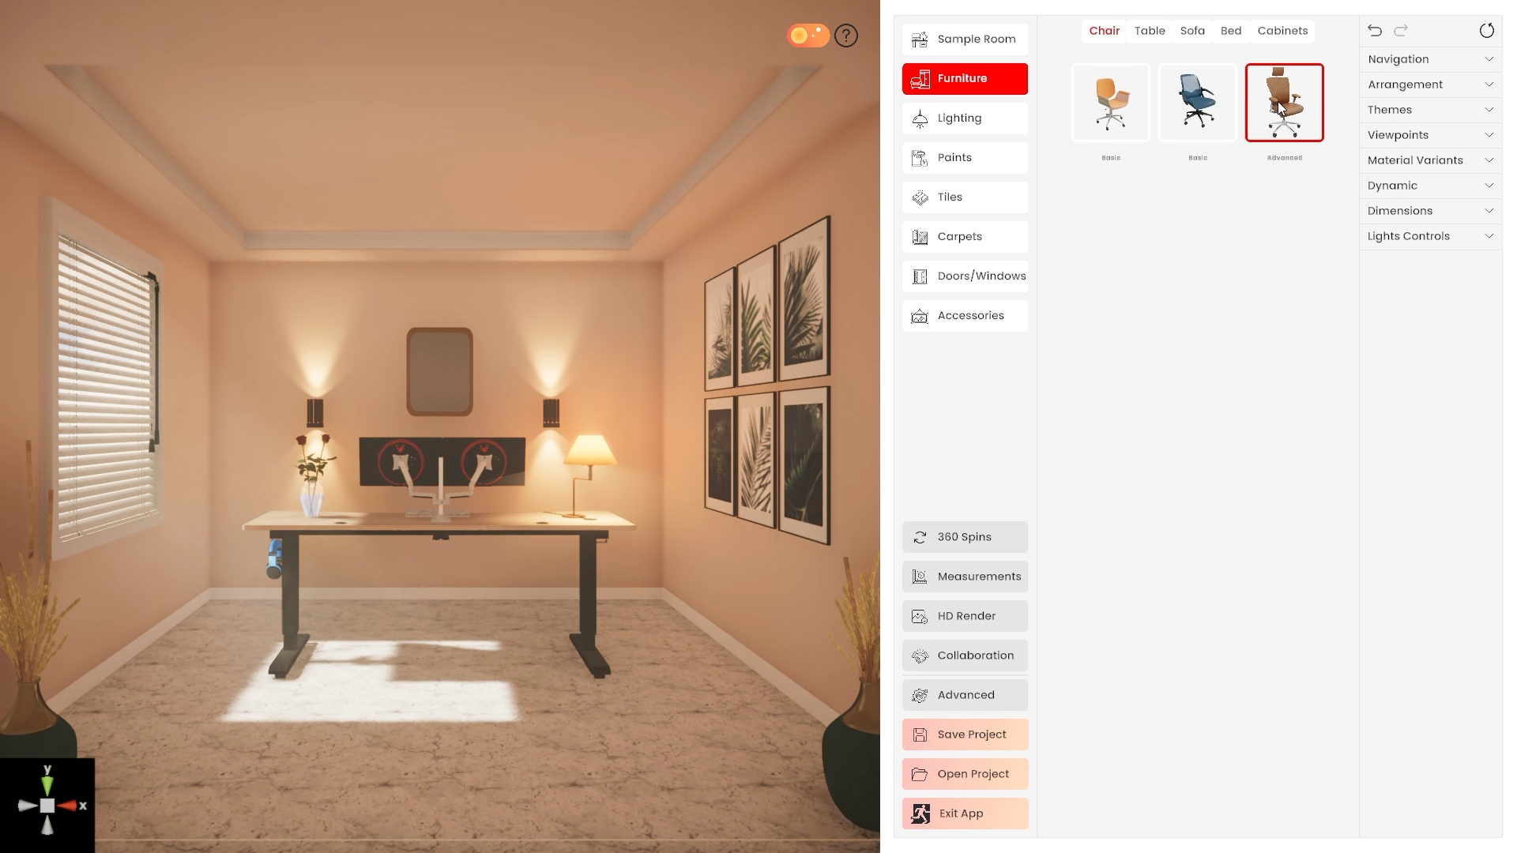
Introducing Showroom3D
Showroom3D variants for furniture, lighting, paints, flooring sectors
Showroom3D customized to every customer.
Customer’s catalog transformed to 3D & embedded in Showroom3D
Web-Browser
HTML5 Compliant
For e.g., Google Chrome, Microsoft Edge, Apple Safari
Native
Windows, iOS, Android
Smartphone, tablets, pc, kiosk

Slide 8
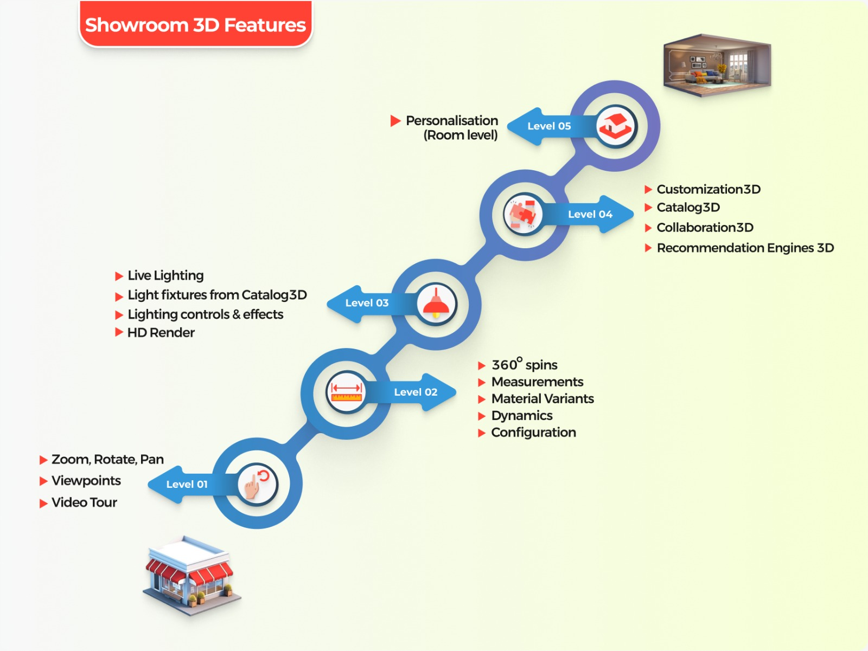

Slide 9
Showroom3D – Service-Provider Portal
Service providers
Painters, tile-masons, electricians etc.
Directory
Name, Tel# etc.
Ratings system
0 – 100%
Portfolio
Showcase service-provider works etc

Slide 10
Showroom3D
10x Impact

Slide 11
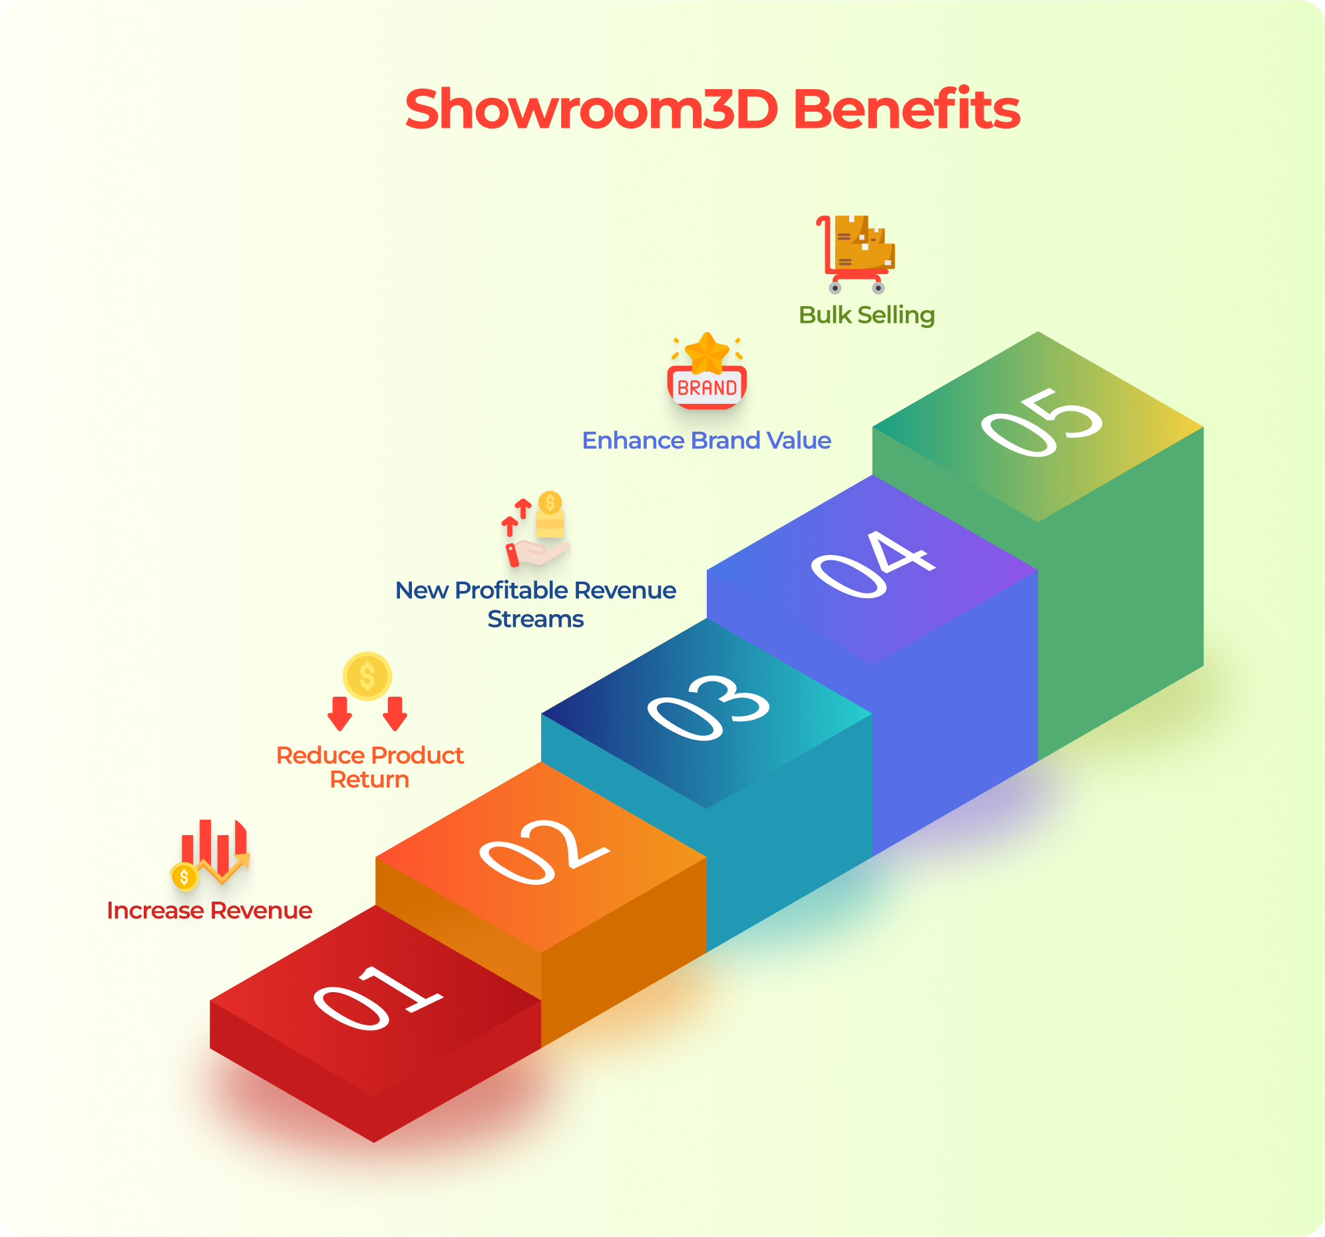
100% ROI within a year

Slide 12
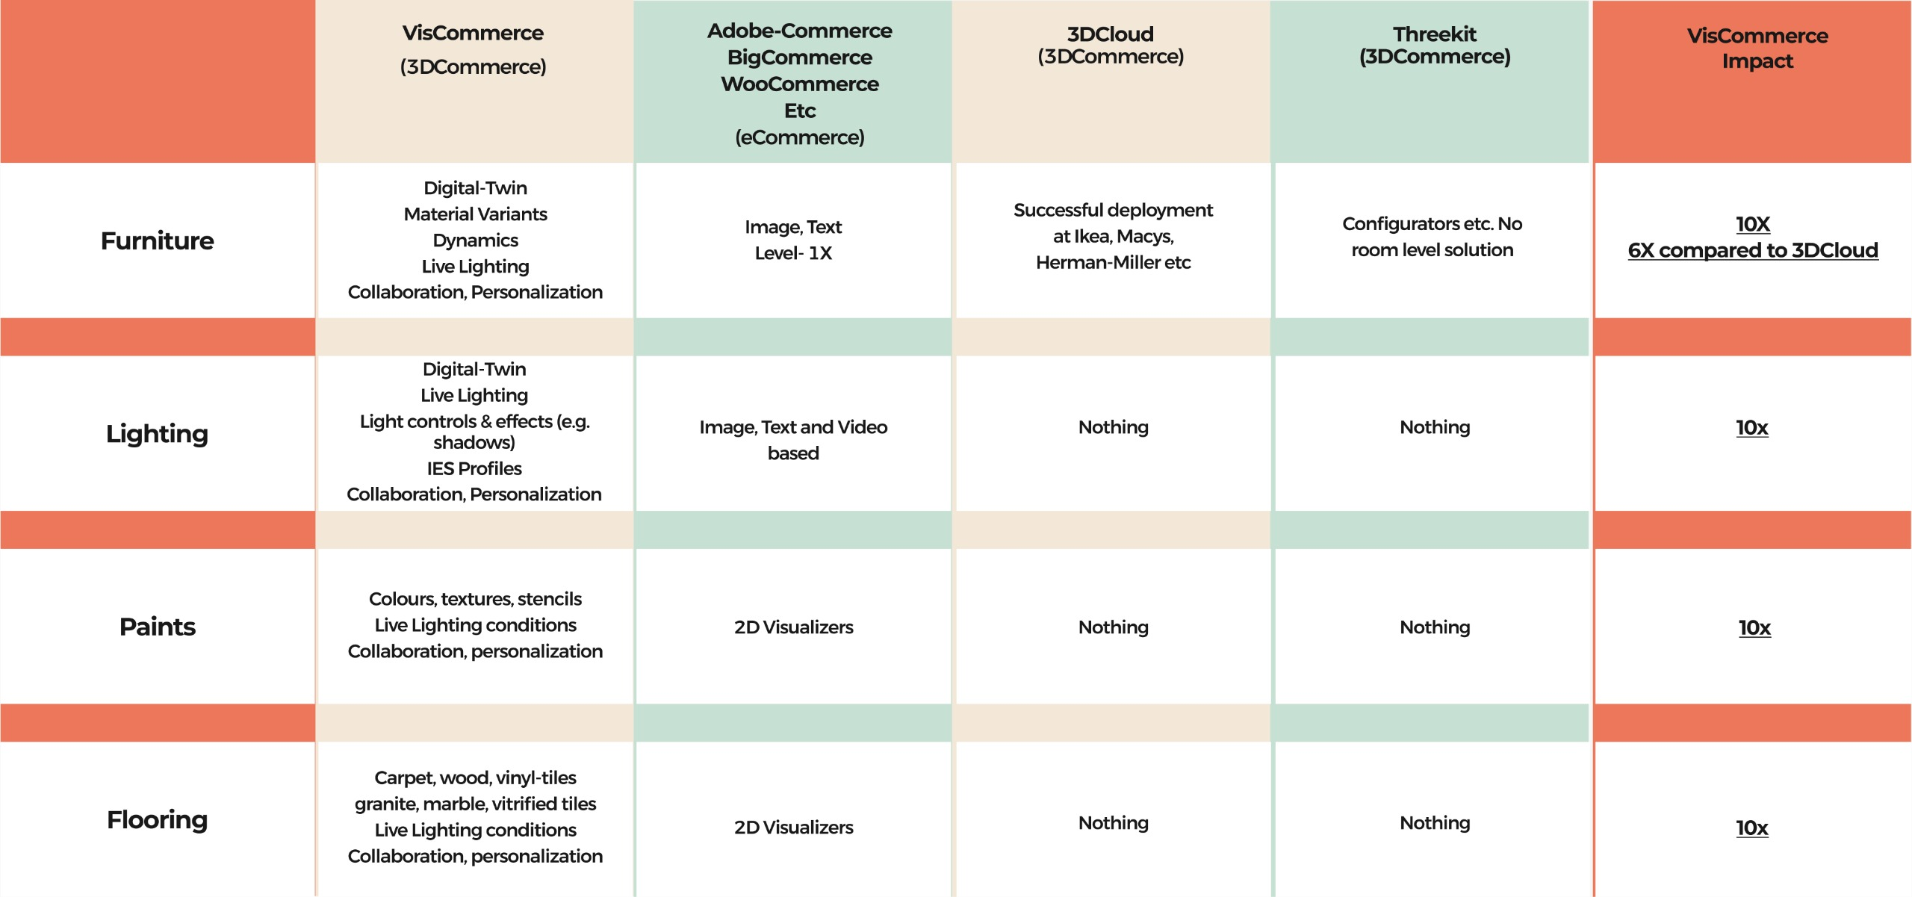
Showroom3D - Differentiation

Slide 13
Competitive Scenario
3DCloud
Raised approx. $45 million in investment
Approx $15 million in ARR
RoomPlanner product adopted by Ikea, Macys etc.
Principal competitor for Showroom3D
https://3dcloud.com/
Threekit
Raised approx. $60 million in investment
3D Product configurators
https://www.threekit.com/
Others
3DCommerce startups attracted approx. $500 million investment
Focused on other markets
Sports, Electronics etc.
https://Khronos.org apex body for 3DCommerce

Slide 14
Entry Barriers
Technical expertise
Leverage expertise in foundational technologies
Innovations protected by patents (USPTO, IPO)
Trademark protection for Showroom3D
Pain points
Close engagement with companies in target sectors to under-stand their pain points
Showroom3D designed with pain-killers to address pain-points
3DCommerce compliance
Consistent experience across software and hardware platforms.
Windows, iOS, android
Smartphone, tablet, pc, kiosk
PBR – Physically Based Rendering – Ensuring compliance to laws of physics

Slide 15
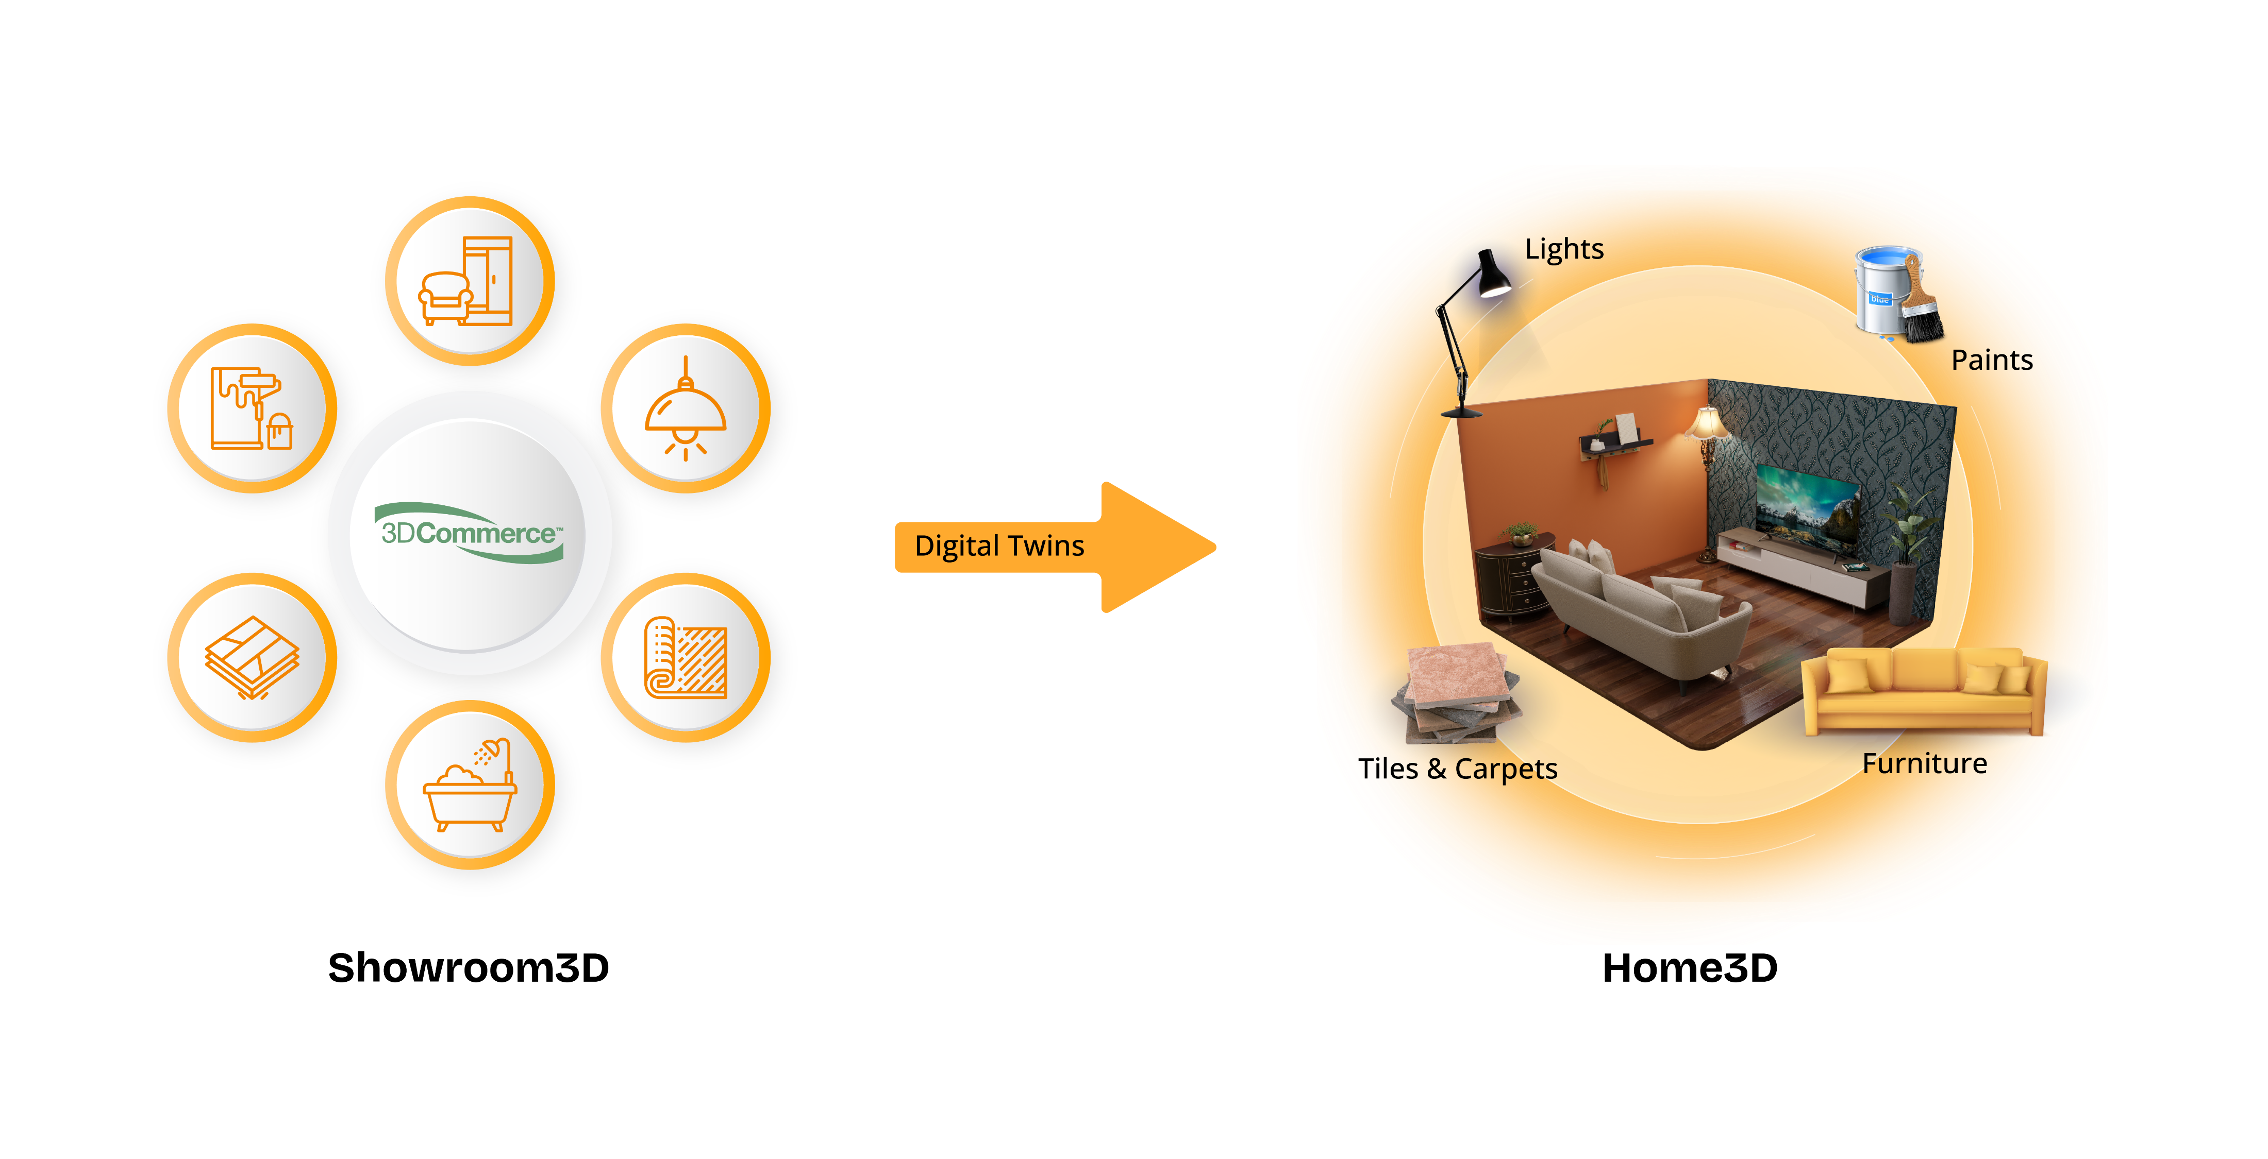
Network Effect →Moat
As Showroom3D network grows its value to Home3D network grows which in turn fuels growth in Showroom3D network. This virtuous network effect can gradually develop into a powerful moat.
In future expand the Showroom3D network by addressing sanitary-ware, kitchen, back-yard etc.
In future expand the Home3D network to Office3D and other commercial spaces.

Slide 16
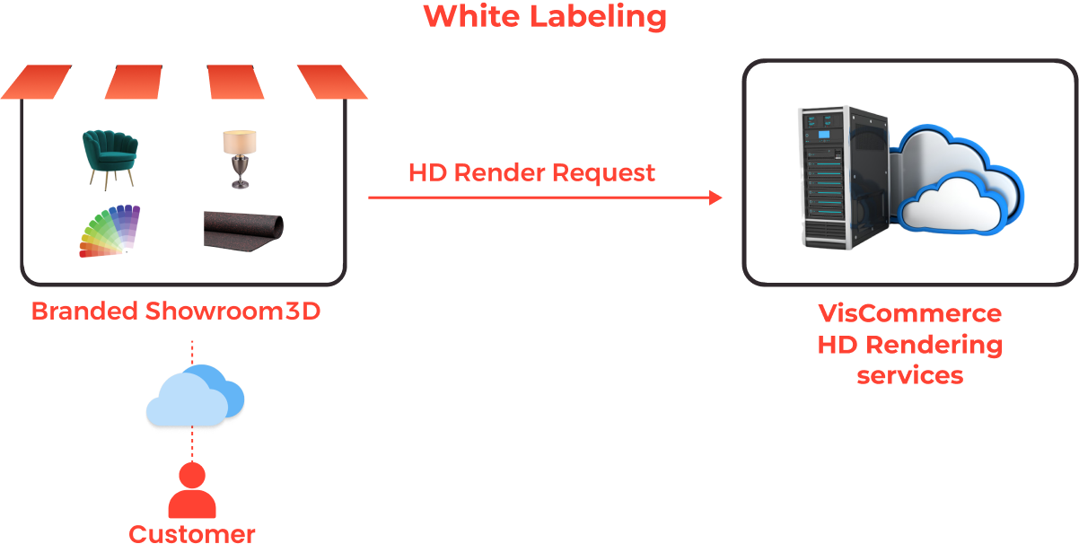
On-prem or SaaS
Revenue sharing between customers & VisCommerce
Highly profitable HDRender feature

Slide 17
Product Management – Early engagement with target markets
Showcase features by leveraging power of technologies. (10x Impact)
Identify pain-points in target sectors by engaging with key execs, customers etc.
Study existing deployments and dynamics of Commerce and eCommerce

Slide 18
Marketing (Outbound)
Website
Sector wise narrative of pain-points, solutions and benefits.
Videos for use-cases
Visitor registration, subscription
WhatsApp integration
Social Media
Content calendar
LinkedIn, Instagram
Social listening
Videos
Overview, Sector wise use-cases, separate videos for specific key features (e.g., Collaboration3D)
Partnerships
eCommerce companies & cloud companies
Won Microsoft-For-Startups ($350 k credits for Azure, Office365 etc. Sales & marketing support)
Endorsements
Trade bodies, thought leaders, market influencers
Reaching out to “American Lighting Association”, Khronos, Furniture associations etc.

Slide 19
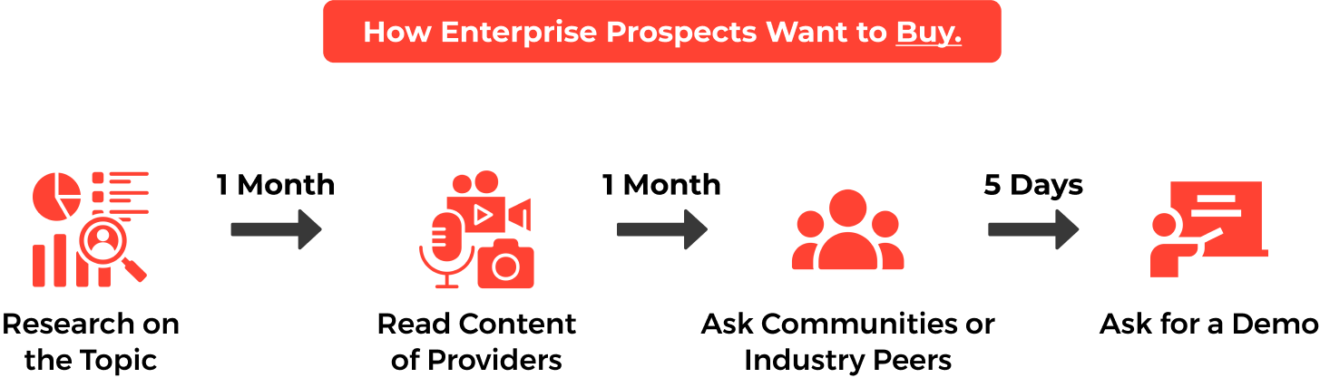
Sales
B2B
Enterprise purchase model
Database of prospects
CXO’s
Dynamics365
Channels
LinkedIn, Email, Telephone
Email
Reach out via MailChimp etc.
Consultants
Salesamore.com

Slide 20
Market Traction
Competitors
3DCloud
Room-planner from 3DCloud adopted by Ikea, Macy’s etc.
$15 million Annual-Revenue
https://macys.3dcloud.io/
Threekit
eCommerce store-front embellished with 3D solution for Steelcase
3D Product configurator adopted by furniture company Lovesac
https://www.steelcase.com/products/office-chairs/gesture/
https://www.lovesac.com/
VisCommerce
At pre-revenue stage
6 unique improvements over 3DCloud room-planner solution.
Marketing initiatives underway
Sales process underway

Slide 21
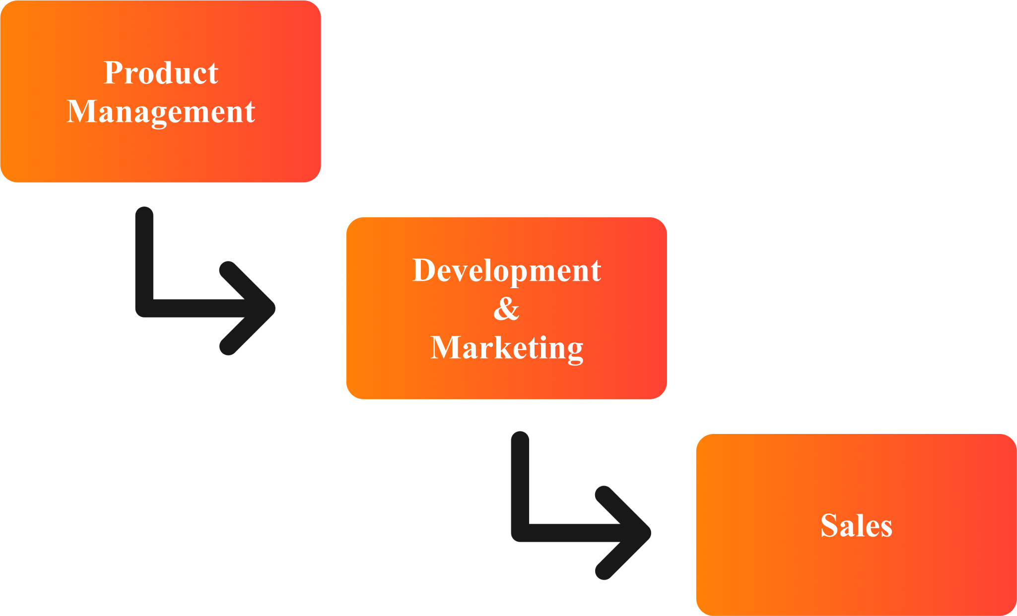
Team
Diverse & Complete
Software, content, marketing, sales
2D, video, 3D content development
Software engineering expertise in 3D, AI, cloud, database, crypto technologies
Leadership
Led by Ramakrishna J Tumuluri, ex-Silicon-Valley (15 yrs)
Team-leads in marketing, engineering and content
Process
Using proven Silicon Valley play-book.
Consultants
Legal - tarulegal.com
Sales - salesamore.com
Recruiter - career-experts.in

Slide 22
Financials
Burn-rate
Approx $10k per month
Employee salaries
Consultants (Legal, Sales, HR)
Software licenses
Cloud hosting
Total investment
Approx $750 k
Expected deal size
$100 k
Subscription model with monthly payments $3k – 5k
Profitable unit economics.

Slide 23
Exit
Long haul
VisCommerce being built for the long-haul
Assembling team with diverse backgrounds and skills
Emulating proven Silicon Valley play book for startups.
Deep, sound, world-class engineering work
Innovations with patents
Trademark for Showroom3D
Engagement with partners, endorsers, prospects, customers, investors
Open to options
IPO
Acquisition (Adobe, Tata’s ?)

Slide 24
Capital
$500k for 10% equity

Slide 25
Thank You
Ramakrishna J Tumuluri
Founder, CEO
rk@viscommerce.com

